Slide 1
Images of the World
What the maps of children can tell us
Amanda M. Witham
ECI 524 (601)

Slide 2
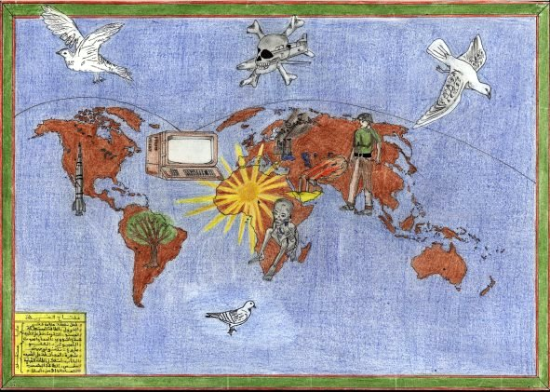
#1 – Algeria – Dreams & Nightmares
First and foremost, the starving child under the sun in sun-Saharan Africa was sad and touching; so much detail, time and emotion went into that one image, the importance accorded it, moved me. This child needed to show the world the sadness and desperation he saw. The images of war and oil in the Middle East, nuclear weapons in the USA, polluting factories in Europe and a giant tree over South America, and technology over all tell me that this artist is very aware of global issues about poverty, the environment, the economy, and above all, war and peace hovering over us all.

Slide 3
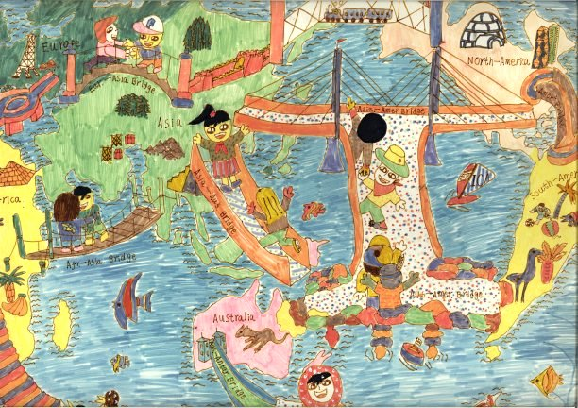
#2 – China – Bridges Throughout
This map shows the world with Asia at the center, a shift from those centered on North American and Europe to which I am accustomed. The bridges connecting the continent, and the friendly smiles and embraces of the people meeting on them, shows promise for a future where all people are respected, welcomed, and celebrated.

Slide 4
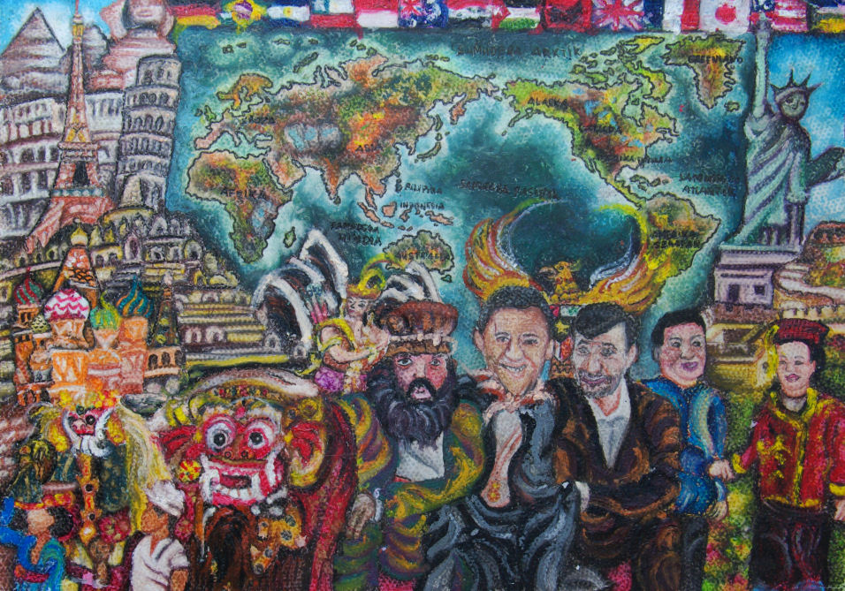
#3 – Indonesia – Points of Light
“Global World Makes Our Life More Beautiful” is a fitting title for this multifaceted and saturated piece. World leaders, world monuments, cultural representations, and the map of the world come together in this image to show that we are a beautiful world full of rich traditions and cultures; Presidents Obama and Ahmadinejad smiling next to each other is one I would dearly love to see repeated in real life.

Slide 5
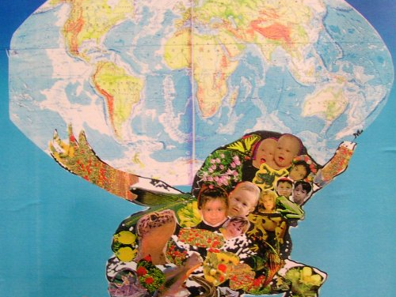
#4 – Israel – The Atlas of the Future
A mixed-media work, this invokes the image of Atlas holding up the world on his shoulders, carrying the burden of and for humankind. This image, however, has made Atlas instead out of nature, food, and children – a powerful statement about not sacrificing our environment, our children’s futures, or the resources we all need to survive.

Slide 6
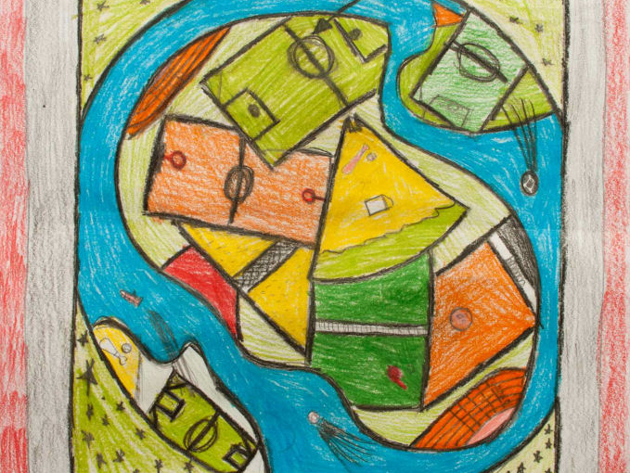
#5 – Norway – The Sport of Life
The Olympic Games is one of my favorite things; I love the competition, with everyone treated fairly, but acknowledging that we are all unique and some of us excel beyond the norm, and celebrating greatness, dedication, and performance. This image, or the earth covered in sports fields, speaks to an enjoyment of life and experience on the part of the artist, and possibly an awareness of the fact that sport is something all people can enjoy and participate in at some level, and it is something that we can all take pride in as a culture, a nation, and a society. There is nothing like it, or the World Cup, for positive national spirit that brings people together.

Slide 7
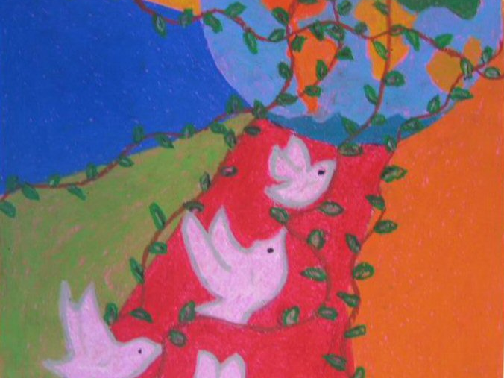
#6 – Turkey – Radiate Peace
Sometimes it is ornate detail and juxtaposition that makes an image or design stand out; for this piece, it was the simplicity. The Earth, from a distance, so all looks beautifully blue-green and clear, encircled with vines, of laurel for education or nature I do not know, but the peace doves encircling the planet in either is a happy thought and a wonderful vision for our future.

Slide 8
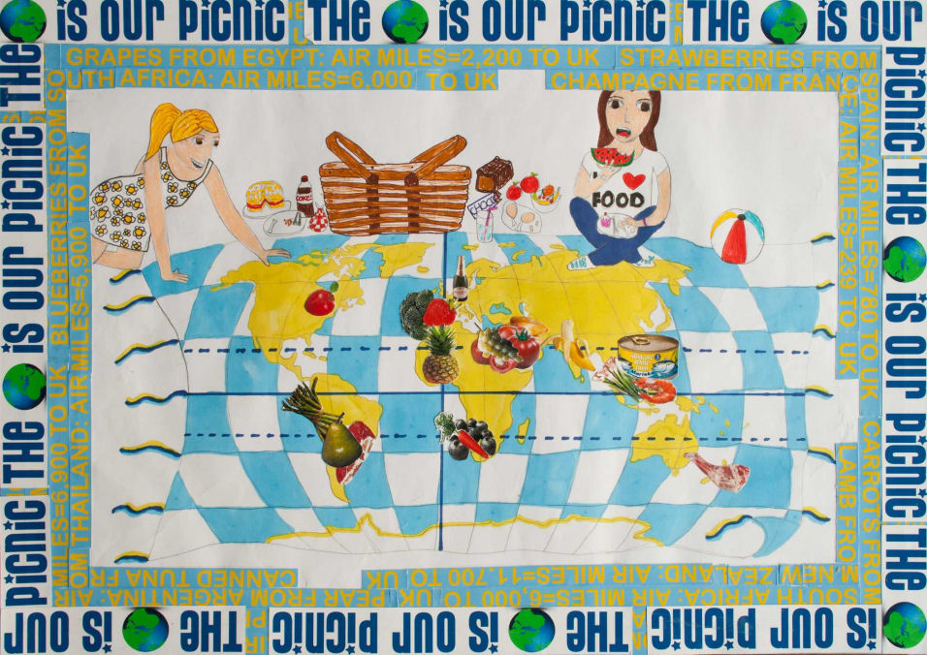
#7 – United Kingdom – Share a Meal
Again, the use of collage and drawing has drawn me to this child’s map of the world. “The Earth is our Picnic” frames the image, along with statistics of distances food travels to get to the UK. Our global food supply chain, and the issues of hunger and poverty that bound in some areas while others consume and waste at alarming rates, is the negative interpretation. However, this sunny, happy picture says more to me, that we are all connected by food, the need and the joy, cuisine is celebrated throughout the world, and it is something around which all people can experience new cultures and share their own with others.

Slide 9
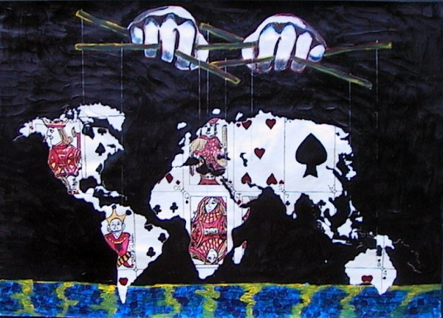
#8 – South Africa - Control
The world as a deck of cards, a fragile structure and a game of chance, controlled by a mysterious, unrevealed power holding the puppet strings, distant and disconnected from the world, possibly a deity or a comment on “the man.” This stark image speaks volumes in symbols.

Slide 10
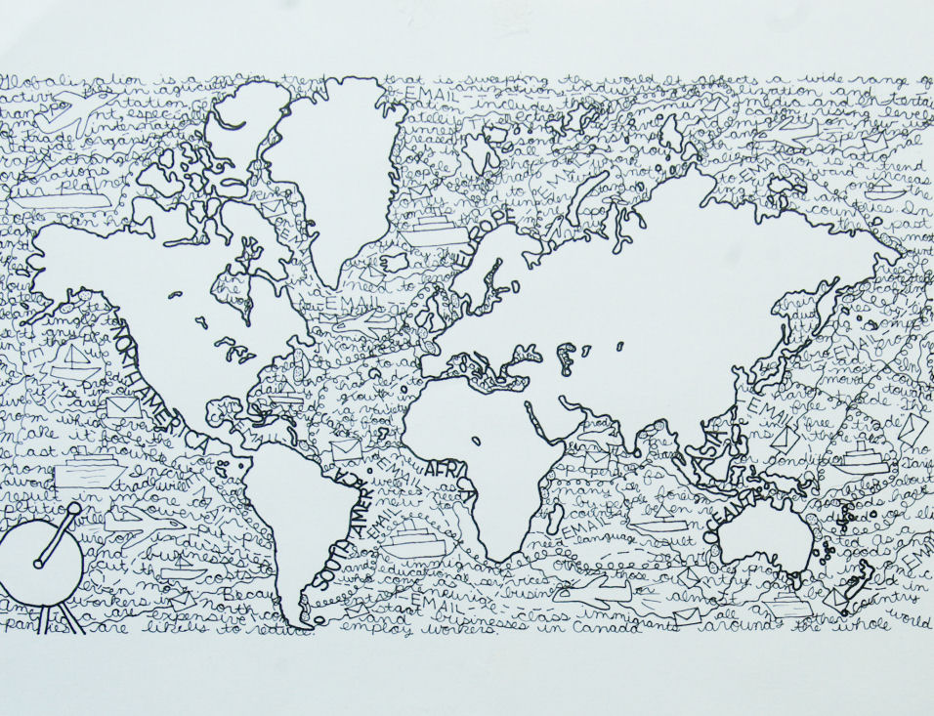
#9 – Canada - Links
From the thumbnail a black-and-white Mercator map is not a stand-out design. Upon closer inspection, the spaces between people and lands, our oceans, are a sea of words – email, business, growth, food, language, class, and one and on – that show the bridges, concrete and abstract, that bind us in an ever-expanding and changing global society.

Slide 11
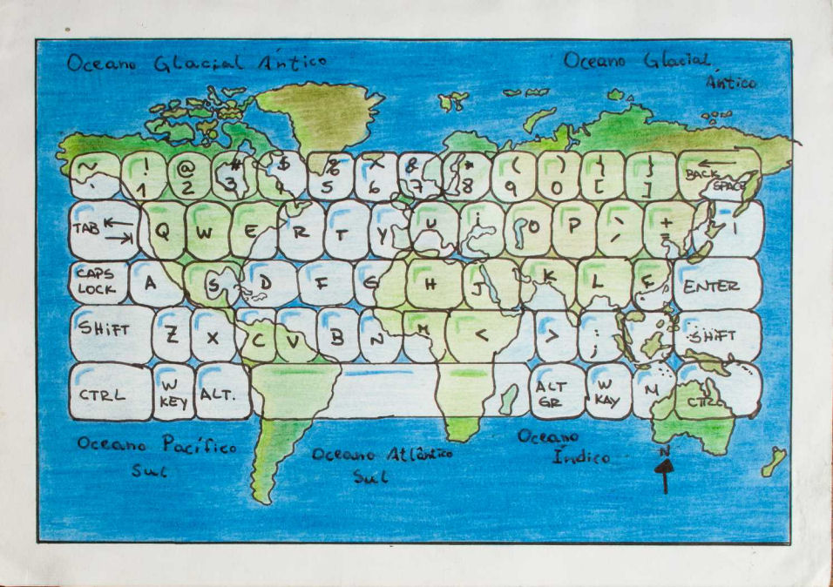
#10 – Brazil – Keys to the World
The world is at our fingertips thanks to technological advances and expanded access, and through new ICT, we can experience and explore the world and the human condition like never before. Movements for freedom, democracy, and peace have spread thanks to technology, and we must embrace the scary and exciting aspects of all of the change.

Slide 12
In-depth on #1: Dreams & Nightmares
Always having taught middle school children, I chose to limit my search to 10-to-14 year-olds. Starting in Africa, I was immediately struck by the small thumbnail of a very detailed map draw by Abolelhak Kadri. First and foremost, the starving child under the sun in sun-Saharan Africa was sad and touching; so much detail, time and emotion went into that one image, the importance accorded it, moved me. This child needed to show the world the sadness and desperation he saw. The images of war and oil in the Middle East, nuclear weapons in the USA, polluting factories in Europe and a giant tree over South America, and technology over all tell me that this artist is very aware of global issues about poverty, the environment, the economy, and above all, war and peace hovering over us all. I love that this child, who sees so much sadness in the world, has three doves of peace and only one image of death and destruction.
An awareness of current events, sociology, and psychology, at some level, are clear from this image. Knowledge of global issues is evident, and the student is clearly thinking critically about the issues and possible solutions, as well as the benefits of conflict resolution. Choosing one strong image, rather than many small symbols, for each continent made the statements about war and poverty more poignant; viewers will want to change the world this child sees. A call to action is a benefit for society, and that is what this image does.

Slide 13
Summary
The maps that I have chosen, upon first glance, have little in common. Some are colorful, some not. Some are detailed, some simple. Upon closer look, the one common thread that ties them together is that each map shows what unites, and in many ways equalizes, the people of the world. Technology is the most common, and the most pertinent to the adolescent mind. Media and digital communication have been a part of their lives since before they could understand them, and these children innately see the potential for technology and the internet to unite all people and provide them with opportunities. The economy is another thing that unites us, positively and negatively, in the images I have chosen. Global trade partnerships affect politics on every level, and that affects people in every part of society. Food, and hunger, is a major part of this economic web as well, and children of the world are acutely aware that children are starving around the world, missing out on what it has to offer them. The third element that unites the world in these images is people getting along, embracing in friendship, and living in peace and harmony. Such a beautiful image, and dream, is one that hopefully this generation of artists can achieve.

Slide 14
Educational Application
To create a sense of global citizenship, I would use this online collection to have students explore the common elements to all of us, or at least among their peer group. To do this, I would first have students, in some configuration depending on age and the students in a particular class, brainstorm what they believe were universal human experiences, values, and/or beliefs. Each child would then choose one to explore and would look for evidence of or against their claim. They would then present their findings, along with their own image depicting their unique vision of the world and humanity, to show what they had learned about life, people, and society from the other children’s work. I would follow-up this work with a literature study to search for these themes in literature. The students would, I believe, learn about different cultures on many levels, but most importantly, the children would learn about the varied points of view that exist in our world; this understanding of the multitude of perspectives that exist is crucial if we want them to eventually be able to collaborate with people on a global, multinational scale.

